Slide 1
PRODUCT SALES ANALYSIS
PHASE 4

Slide 2
Introduction
Product sales analysis is a critical aspect of business operations, as it helps organizations understand their product performance, customer preferences, and market trends.
It can lead to improved sales strategies, inventory management, and profitability.

Slide 3
Data Source
The dataset for the above mentioned project was obtained from kaggle website
Kaggle is an popular dataset providing source where obtained datasets are with high quality and less errors.

Slide 4
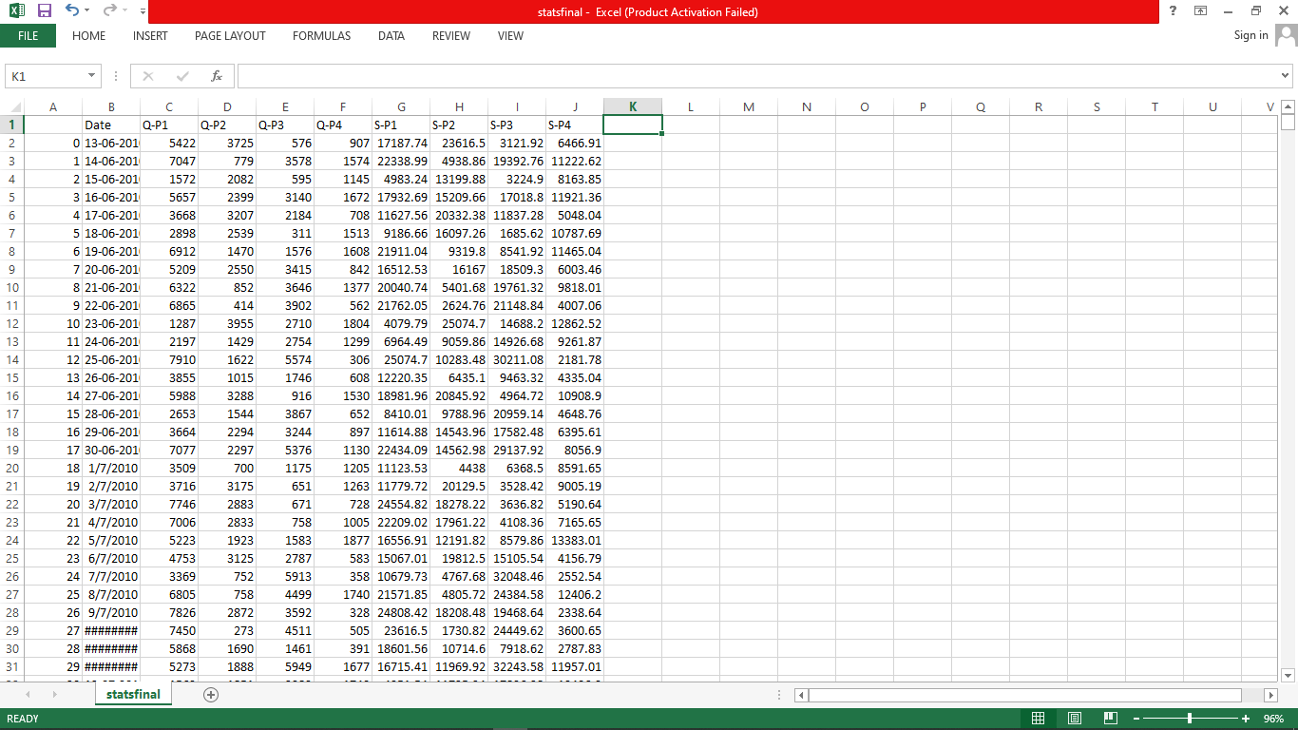
Imported Dataset

Slide 5
We have dataset to analysis but the contains errors and outliers so, we using some techniques to clean the dataset
The techniques are:
Data cleaning
Filling missing value
Removing Duplicate Records
Handling Outliers
2.Data Transformation and Feature Engineering
3.Predictive Modeling
4.Visualization and Reporting

Slide 6
IBM Cognos
Cognos is a business intelligence performance management tools for IBM
It allows technical and non-technical employees in any company to analyse, extract and create interactive dashboards that enable the company to take relevant decisions.
The Cognos tool combines a multitude of products which enables communication with different third parties
In this Phase to visualization and reporting the Dataset by using IBM Cognos

Slide 7
We have to make analyze and report using dataset
perform the three analyze and report
1. top-selling products
2. customer preferences
3. sales trends
And we design interactive dashboards
Dashboards are a type of data visualization, and often use common visualization tools such as graphs, charts, and tables.

Slide 8
DASHBOARD
Top Selling Product
Sales Trend
Customer Preference

Slide 9
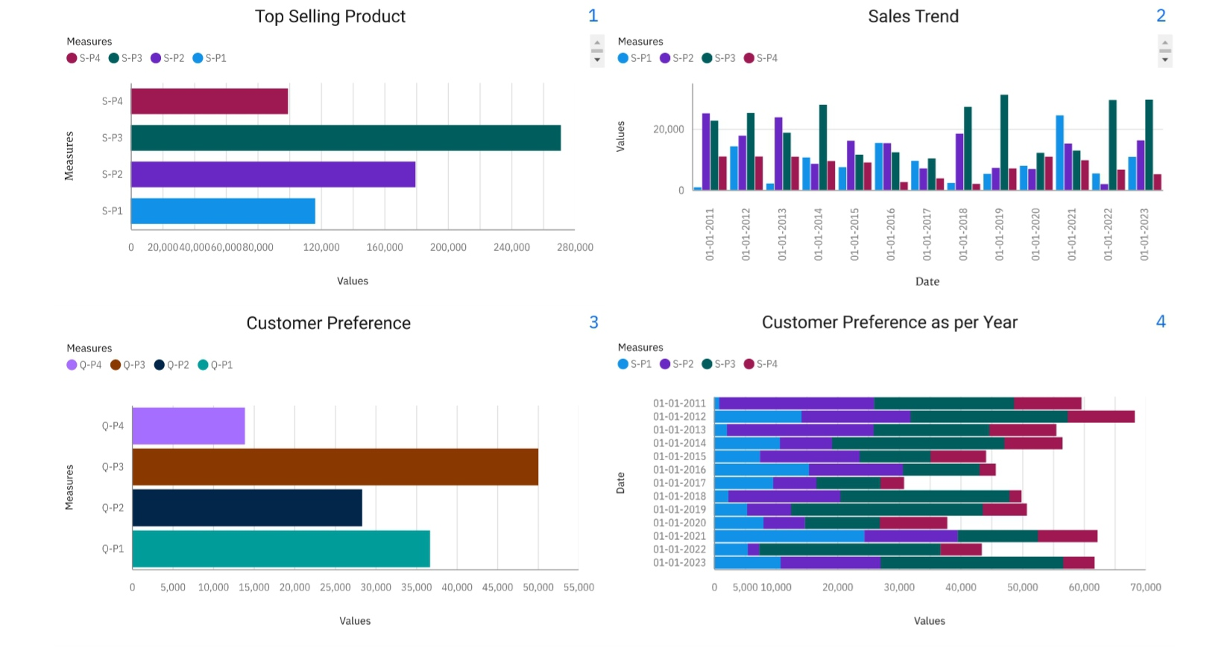

Slide 10
Now in the dashboard we have three analysis top selling products , sales trend ,
customer prefrences
This visualization are done by using bar chart and filtering is applied in the all analysis
In filtering we using date column for filtering all the sales and quantities by Date
In the Dashboard we Conclude
Top selling product : S-P3 has highest selling product by Date
Sales Trend- S-P3 has the maximum sales in all year
Customer preference:Q-P3 has high Quantity and S-P3 has highest sales

Slide 11
Identifying products with the Highest sales
The top-selling product can vary significantly depending on various factors such as time, location, and industry.
It's important to note that the top-selling product in one category or market may not be the same in another
In this dataset has 4 products S-P1, S-P2, S-P3, S-P4 then we find the highest sales through the 4 products

Slide 12
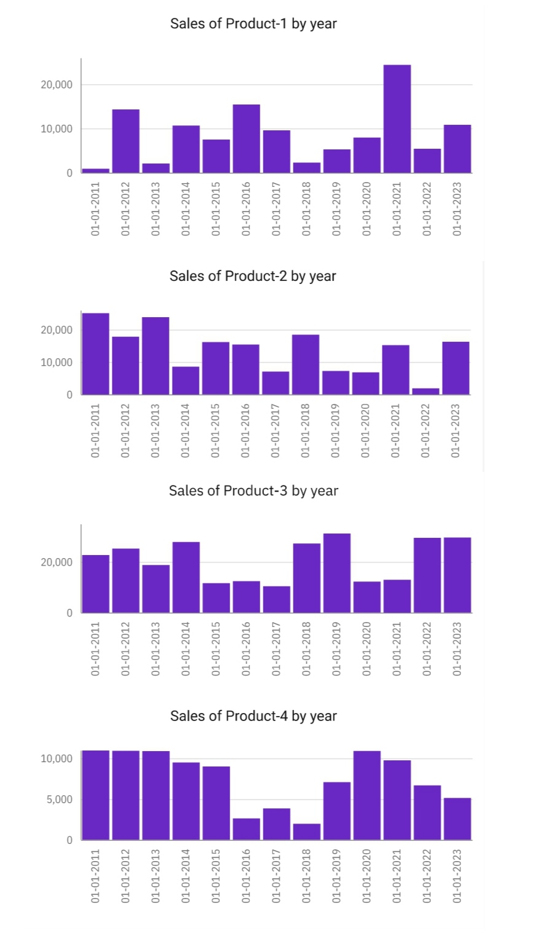
In this graphical represent the year wise sales
we have a 4 column charts (Product 1,product 2, product 3, product 4)
In this case we apply the date on x-axis
Products are apply in y-axis
Dates are filtered as 2011 - 2023

Slide 13
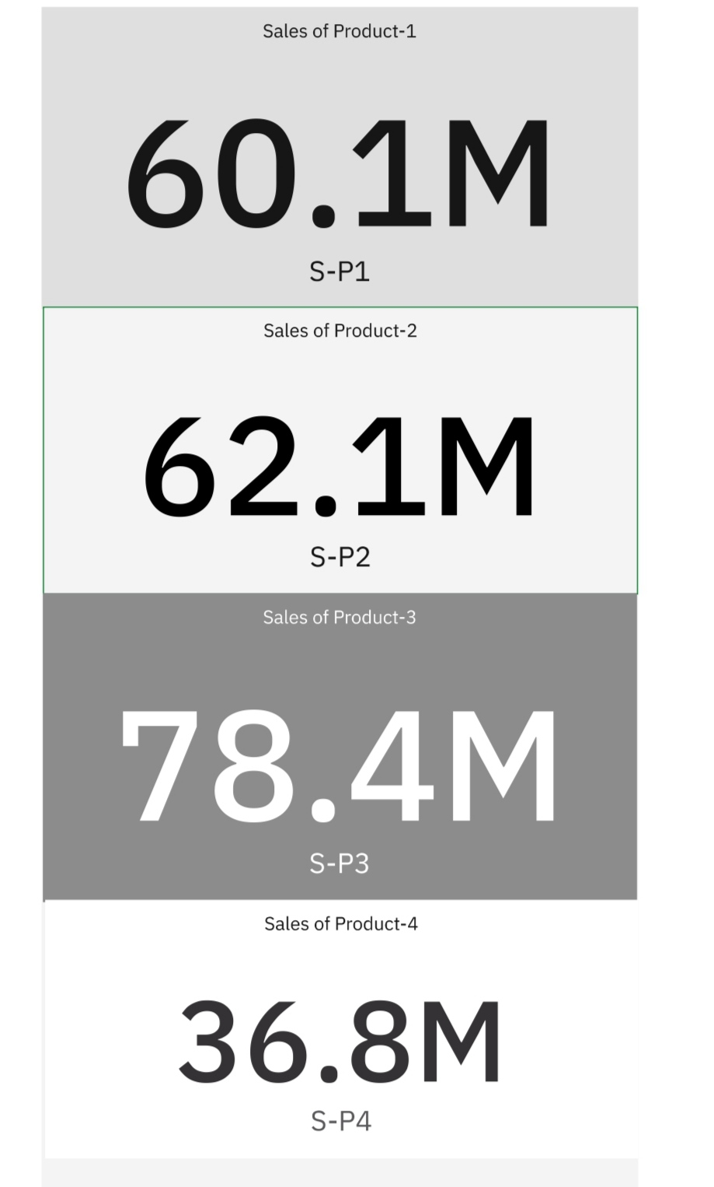
In this summary representation shows the overall sales in all years
Product 1 has 60.1m sales
Product 2 has 62.1m sales
Product 3 has 78.4m sales
Product 4 has 36.8m sales
So finally we conclude S-P3 has highest sales in overall years

Slide 14
peak sales periods
In the context of business and data analysis, refers to the long-term movement or direction in which a company's sales figures are changing.
It involves analyzing historical sales data to identify patterns or tendencies in sales performance over a specific period of time.
Understanding sales trends is crucial for businesses because it can help them make informed decisions

Slide 15
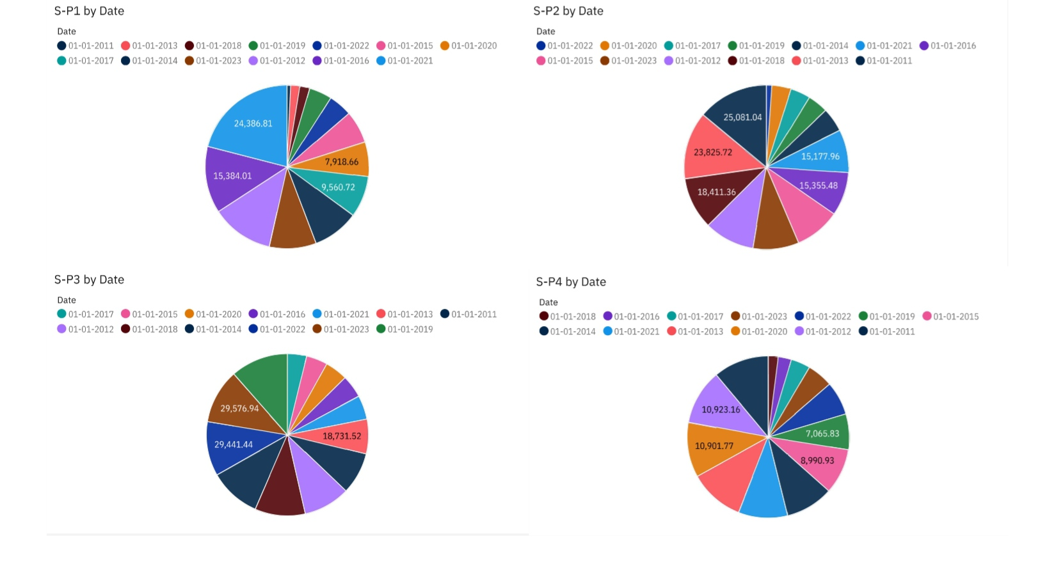

Slide 16
In the above pie chart for find peak sales periods in the year wise
So we include two columns S-P1 by Date , S-P2 by Date , S-P3 by Date ,
S-P4 by Date
Peak sales period for S-P1 in 2021 has 24386
Peak sales period for S-P2 in 2011 has 25081
Peak sales period for S-P3 in 2023 has 29576
Peak sales period for S-P4 in 2012 has 10923

Slide 17
customer preferences
Customer preferences refer to the specific choices, tastes, and desires of individual customers or groups of customers
when it comes to products, services, or experiences offered by a business.
Understanding customer preferences is crucial for businesses because it enables them to tailor their offerings and marketing strategies to better meet customer needs and increase customer satisfaction.

Slide 18
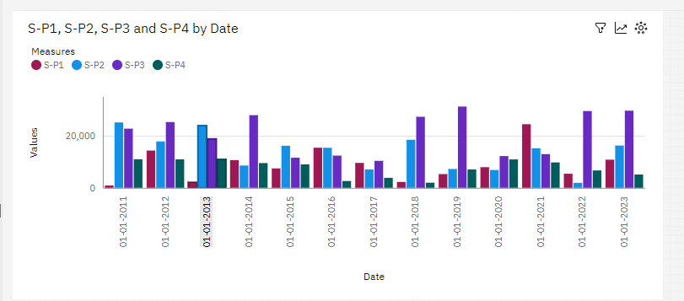

Slide 19
In the above Bar chart for find Customer preference in the year wise
So we include two columns S-P1 by Date , S-P2 by Date , S-P3 by Date ,
S-P4 by Date
Customer Preference is based on Price , Quantity etc..,
But in this case we preference using product Sales
Customer Prefer the S-P1 in the year 2021
Customer Prefer the S-P2 in the year 2011,2013,2015
Customer Prefer the S-P3 in the year 2012,2014,2017,2018,2019,2020,2022,2023
No one prefer the S-P4 in all the year
In 2016 S-P1,S-P2 has equal preference by Customers

Slide 20
Conclusion
product sales analysis empowers businesses to make informed decisions, optimize their operations, and achieve greater profitability.
By leveraging data, visualizations, and insights, companies can adapt to market dynamics and stay competitive in a constantly evolving business environment.

Slide 21
Thank You

